Slide 1
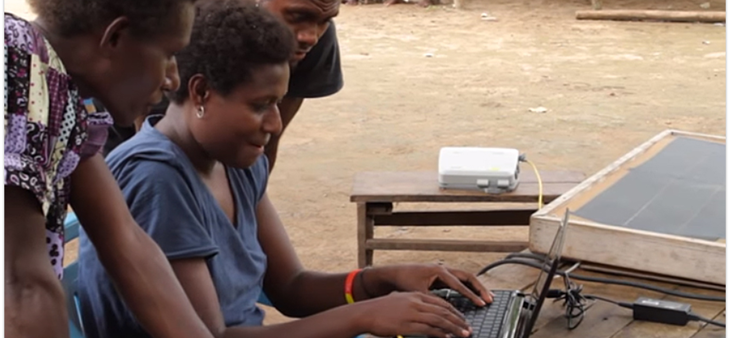
Give instruction to a wise man, and he will be still wiser; teach a just man, and he will increase in learning (Prov. 9:9).
All Scripture is taken from the New King James Version®. © 1982 by Thomas Nelson, Inc. Used by permission. All rights reserved.
Refinement and Revision Resources

Slide 2
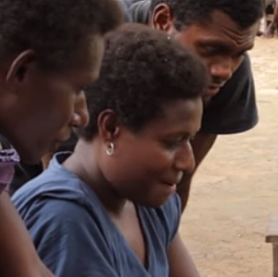
After the 8 Steps of MAST
Refinement: a process that includes other Christians from the language community

Slide 3
Ecclesiastes 4:9-12
Two are better than one, Because they have a good reward for their labor. ¹⁰ For if they fall, one will lift up his companion. But woe to him who is alone when he falls, For he has no one to help him up. ¹¹ Again, if two lie down together, they will keep warm; But how can one be warm alone? ¹² Though one may be overpowered by another, two can withstand him. And a threefold cord is not quickly broken.

Slide 4
?
Generate Scripture interest
Insight: how community understands translation
Why include others?
Build relationships and ownership

Slide 5
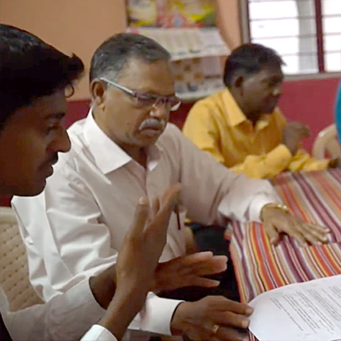
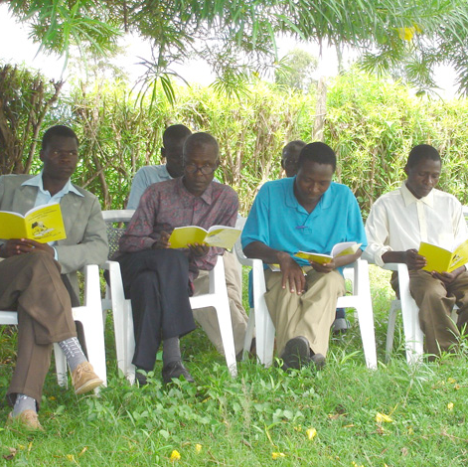
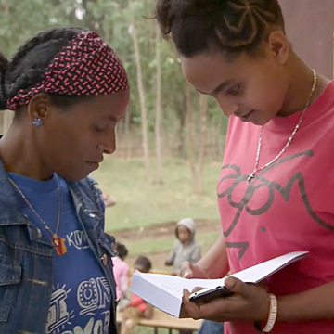
How to Include Others
Bible study/small group activity
Sunday school class
One-on-one in homes

Slide 6

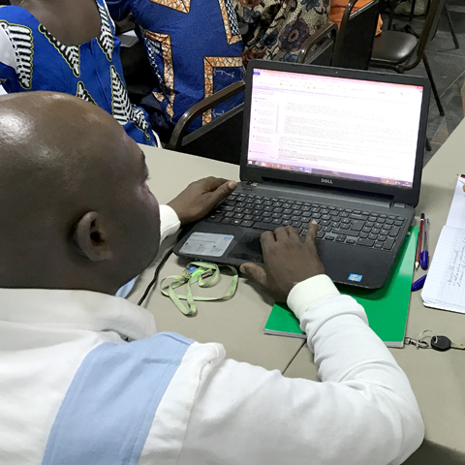
Bibleineverylanguage.org

Slide 7
Revision Keeping the Translation Current/ Generational Ownership
Language changes over time...
Plan by the church to revise the translation
When need is identified
Every 5 years or other

Slide 8
Refinement and Revision Resources
Translation Topics
Translation Manual
Reviewers’ Guides & Application Guides for Doctrines
Greek Words for Translators
Bible Commentary

